Slide 1

Programming Concepts
Coding Life
Presentation by:
D. PHIRI
LECTURER ICT DEPARTMENT

Slide 2

Lesson Outline
Programming Concepts
Programing Styles
Programming Languages
Variables
Data types
Arithmetic Operations and operators

Slide 3


Concepts: Coding styles
Procedural Programming
Object Oriented Programing:

Slide 4
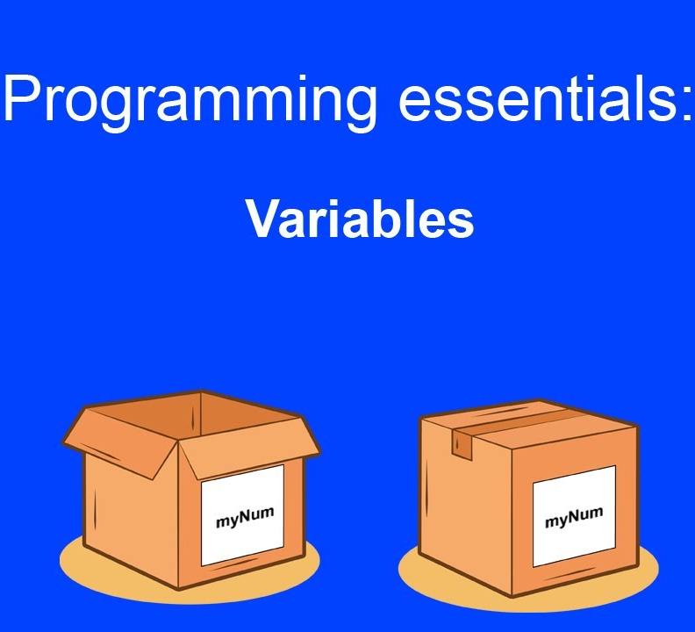
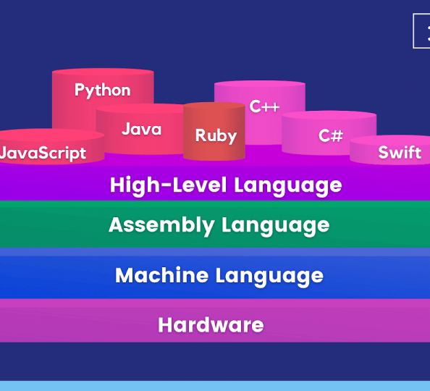
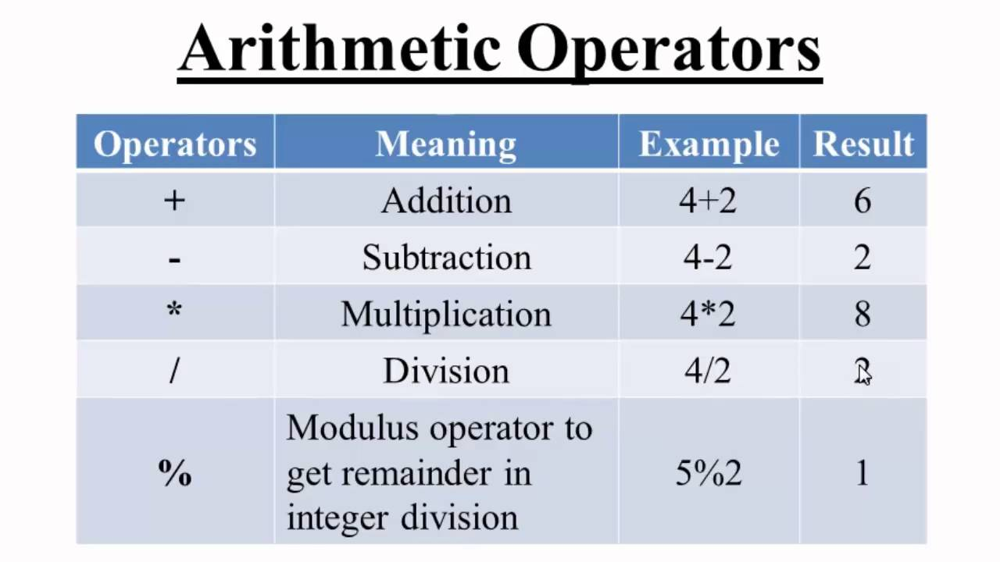
Code: Concepts
Variables
Languages
Operators

Slide 5
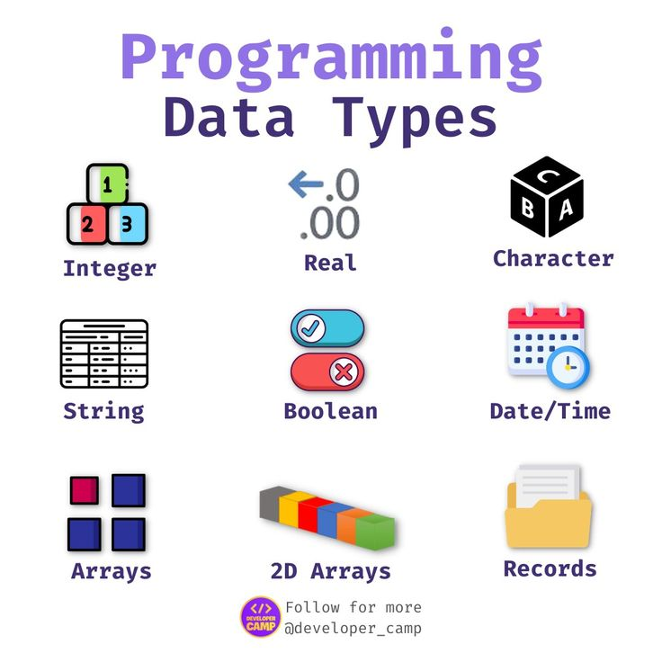
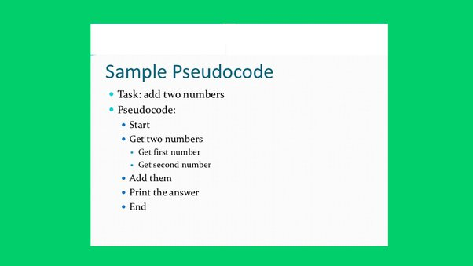
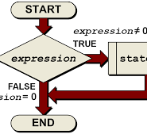
Code: Concepts
Data Types
Pseudo Code
Statements and Expressions

Slide 6
Concepts:
Pseudocode:
Pseudocode is an informal high-level description of the steps involved in solving a problem.
It is typically written in a natural language, such as English, and is used to communicate the general flow of a program or algorithm to other programmers or stakeholders.
Pseudocode is not meant to be executed by a computer, but rather to serve as a blueprint for the actual implementation of the program.
Begin.
PRINT “Please enter two numbers to add”
READ num1.
READ num2.
Sum = num1+num2.
PRINT Sum.
End.

Slide 7
Concepts:
Statements are complete commands that instruct the computer to perform a specific action.
They typically end with a semicolon (;) and can include assignments, function calls, loops, conditional statements, and more. Statements modify the state of the program by changing the values of variables or performing some action.
Expressions, are combinations of operands (variables, constants, operators) that evaluate to a single value. They do not modify the state of the program and are often used as part of statements.
Expressions can include arithmetic operations, logical comparisons, function calls, and more.

Slide 8
Concepts:
Syntax
Syntax defines the set of rules that determine whether a sequence of characters or tokens forms a valid program.
It specifies how different elements of a programming language, such as keywords, identifiers, operators, and statements, should be arranged to create meaningful code.
Syntax errors occur when the code violates these rules, making it difficult or impossible for the compiler or interpreter to process the program.

Slide 9
Concepts:
Semantics
Semantics, on the other hand, focuses on the meaning of the code. It defines how the program behaves when executed.
Semantic analysis involves understanding the purpose of each statement and expression, evaluating their validity, and ensuring that the program performs the intended task.
Semantic errors arise when the code is syntactically correct but does not produce the desired output or exhibits unexpected behavior.

Slide 10

Summary
What we’ve learned so far
What is a variable?
What are data types
What is a pseudocode?
What is the difference between statement and expression?
What is the difference between syntax and semantics?

Slide 11
Thank you

